Slide 1


1
Project plan
Introduction to the course
by Jan Bollen
j.w.bollen@saxion.nl

Slide 2
2
The book
Project needs structure
Project needs questions
Chapters of project plan
Background
Results
Activities
Limits
Products
Quality
Organisation
Schedule
Costs and benefits
Risks
Agenda

Slide 3

The book
3
Project
Management
Roel Grit
(any version
of the book
is good)

Slide 4


Project needs structure
4

Slide 5
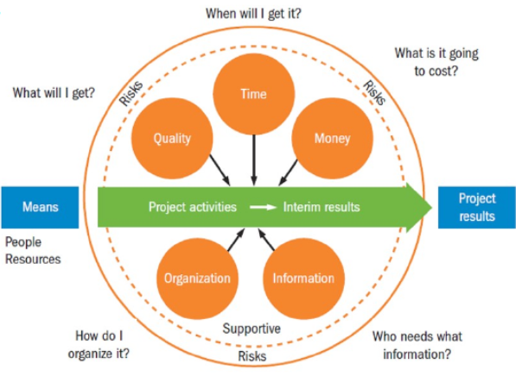
Project needs questions
5

Slide 6
Chapters
6
of project plan (framework on BB)
1 Background info | Where (in what environment) will the project be carried out?
2 Project results | Why carry out this project and what is the desired final result?
3 Project activities | What do we need to do to achieve the project goal?
4 Project limits | What are the boundaries of the project?
5 The products | What are the intermediate products?
6 Quality control | How can we ensure the sufficient quality of all products?
7 Project organization | Who is participating and how do we plan to collaborate?
8 Schedule | Who is doing what / when?
9 Costs and benefits | What will the project cost and what will it yield?
10 Risks | What could cause the project to fail?

Slide 7
1 background info
“Where”
7
Description of the environment
Backgrounded elements in order of decreasing size
Top down
1 the organisation
2 the business unit
3 the department
4 your project

Slide 8
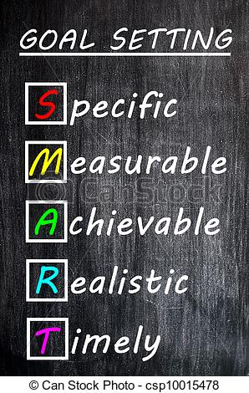
2 project results
“Why”
“What”
8
The project objectives; the goal
Make a more than clear assignment
1 design assignment
2 research assignment
a improvement
b technical
Inclusive results
1 product
2 research result
2a advise
2b conclusion

Slide 9
3 project activities
Methodology
(see also ppt on methodology)
9
Choose a methodology and describe why this methodology fits with your assignment
Think first, then act!
Think through project in detail
  from start to finish AND
  from finish to start.
Work from global to detail
  Top-down working
  First the big picture
  Then the details!

Slide 10
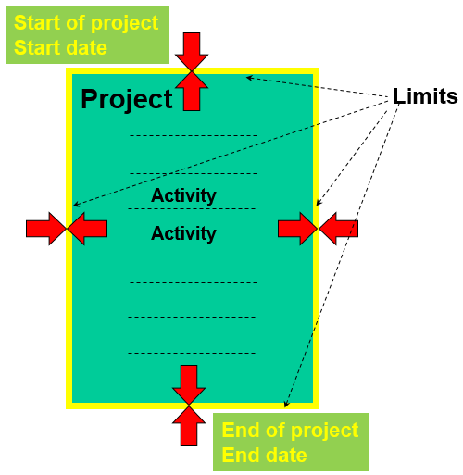
4 project limits
10
Time
Start date
End date
Budget
Product
Demo or
Ready for
Production

Slide 11
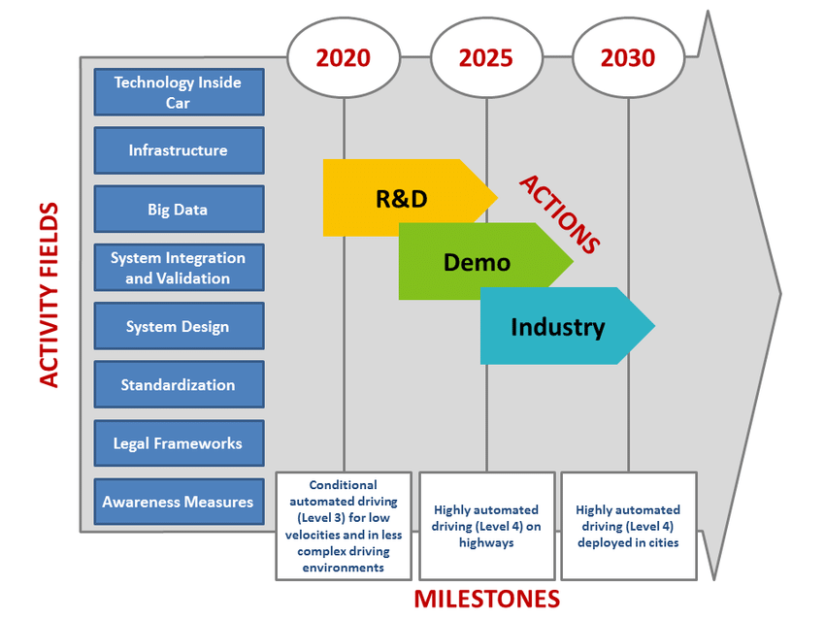
5
The products
11
Intermediate products and end product definition

Slide 12
6
Quality control
12
How do you know that your quality is sufficient:
Desired quality
it it good enough at the end for your sponsor
Intermediate quality
keep your sponsor contacted about the quality
of the project at any time
Keep checking the quality
Ask for feedback
Request external advise
Indicate what tools and techniques are needed for making diagrams etc.
Indicate what software you have to use
Don’t forget to explain why you use other programs or things than usual.

Slide 13
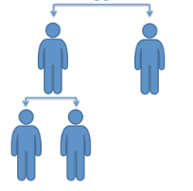
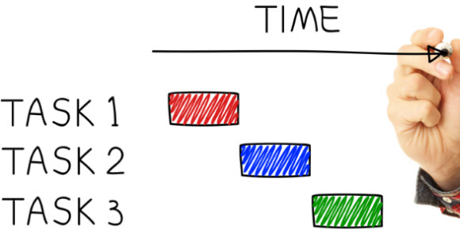
7
Project organisation
13
Intermediate products and end product definition

Slide 14
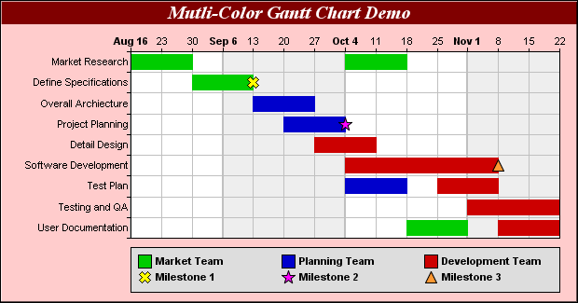
8
Schedule
Gantt diagram
14
Time versus activities and milestones
All documentation and Mid- and end- term return days

Slide 15

9
Costs and benefits
15
Costs; man-hours / material / mentoring hours
Benefits;
Product
Solution
Advise

Slide 16
10
Risks
16
List the most possible risk to fail the project
Internal
lack of time
lack of budget
External
lack of components
lack of information

